Slide 1

Notes:
When the weather gets warmer, it’s natural to want to get outside and do all the awesome things you might not have been able to over the winter. It’s a great time! However, you do need to protect yourself from the sun. Let’s go over some true/false questions to set the record straight.

Slide 2

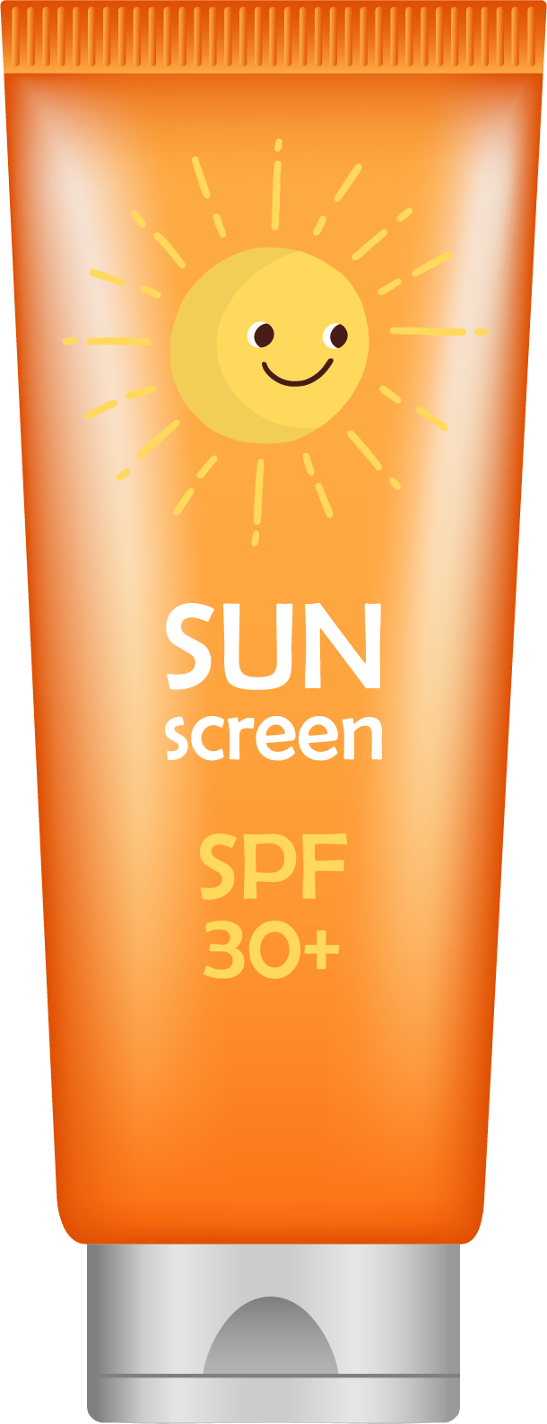
Notes:
True or false: People who tan easily and don’t get burned don’t need sunscreen.

Slide 3
Notes:
False. Any change in skin color is hard on it. There’s no such thing as a healthy suntan. Just because you don’t burn doesn’t mean you can leave sunscreen at home.

Slide 4

Notes:
True or false: People with darker skin don’t need sunscreen.

Slide 5
Notes:
False. Everyone needs sunscreen. No matter how dark your skin is or how tan you get, the sun’s UV rays still damage your skin.

Slide 6

Notes:
True or false: You should apply sunscreen every two hours.

Slide 7
Notes:
True. Put it on more often if you’re at the pool or beach.

Slide 8
Notes:
True or false: Sunscreen is not the only kind of sun protection.

Slide 9
Notes:
True. Sunscreen is just one tool for your sun protection toolbox. You can also wear long clothing, rest in the shade, take breaks from the sun or wear a hat.

Slide 10
Notes:
Playing outside is super-fun and healthy! So is using sun protection. It’s easy to do! Ask a parent to help with hard-to-reach places!

